Slide 1

PiCar-X V2 Ball Follower Robot
An Autonomous Vision-Based Tracking System
Houston City College | ITAI 2374
Jesus Ocampo and Ahad Maredia
Professor - Sitaram Ayyagari

Slide 2
Problem Statement
Challenge
Objective
Modern robotics demands seamless integration of sensors and actuators for autonomous operation. This project addresses the need for a real-time object tracking system that demonstrates:
Design and implement an autonomous ball-following robot that showcases practical applications of sensor fusion, proportional control systems, and obstacle avoidance algorithms in a compact educational platform.
Computer vision integration with mobile platforms
Sensor-actuator coordination
Real-time decision making under dynamic conditions
Safe autonomous navigation

Slide 3
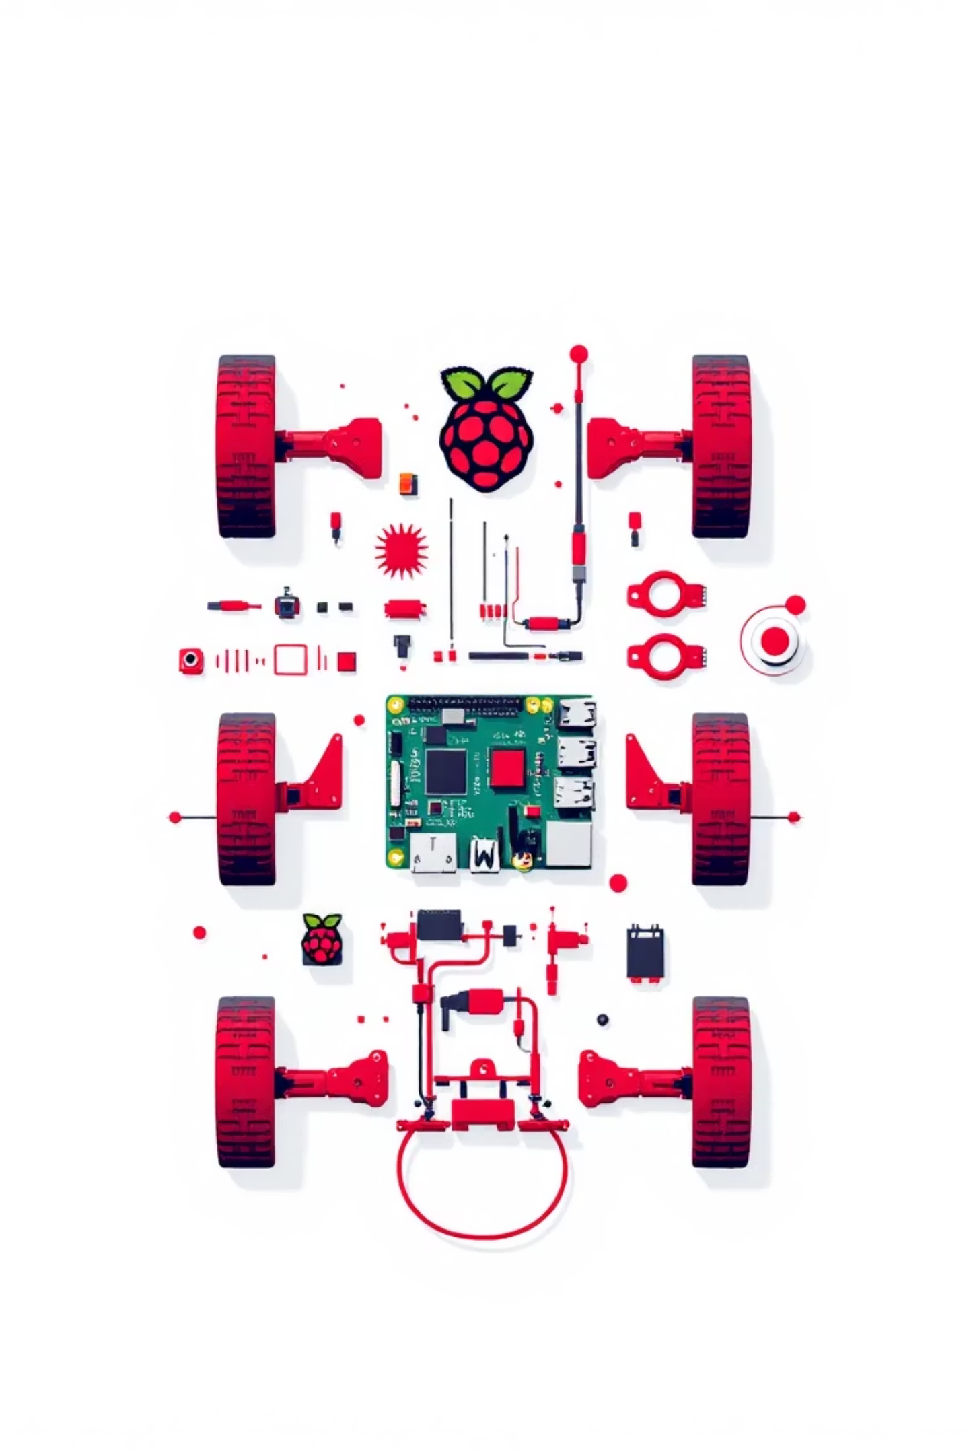




Hardware Platform Overview
Vision System
Wide-angle USB camera for real-time object detection and color tracking
Ultrasonic Sensor
HC-SR04 for obstacle detection with 2cm-400cm range
Servo Motors
Pan-tilt servos for camera positioning and directional steering
Raspberry Pi 5
Central processing unit running Python-based control algorithms

Slide 4
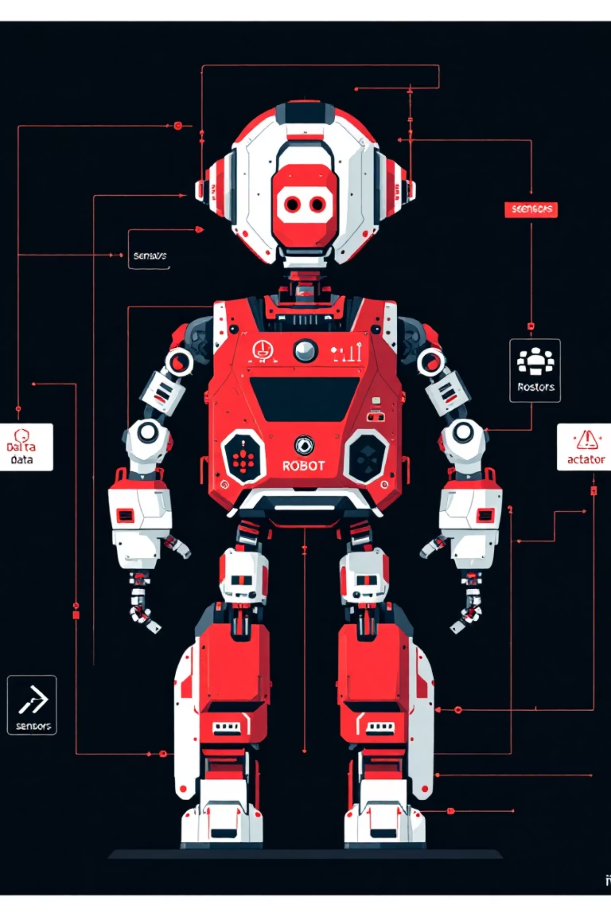




System Architecture
Data flows through integrated subsystems to enable autonomous tracking behavior
Image Acquisition
Camera captures video stream at 30 FPS
Object Detection
OpenCV processes HSV color space for ball identification
Servo Control
Proportional controller adjusts camera pan-tilt angles
Motor Commands
Drive motors execute movement based on tracking offset

Slide 5
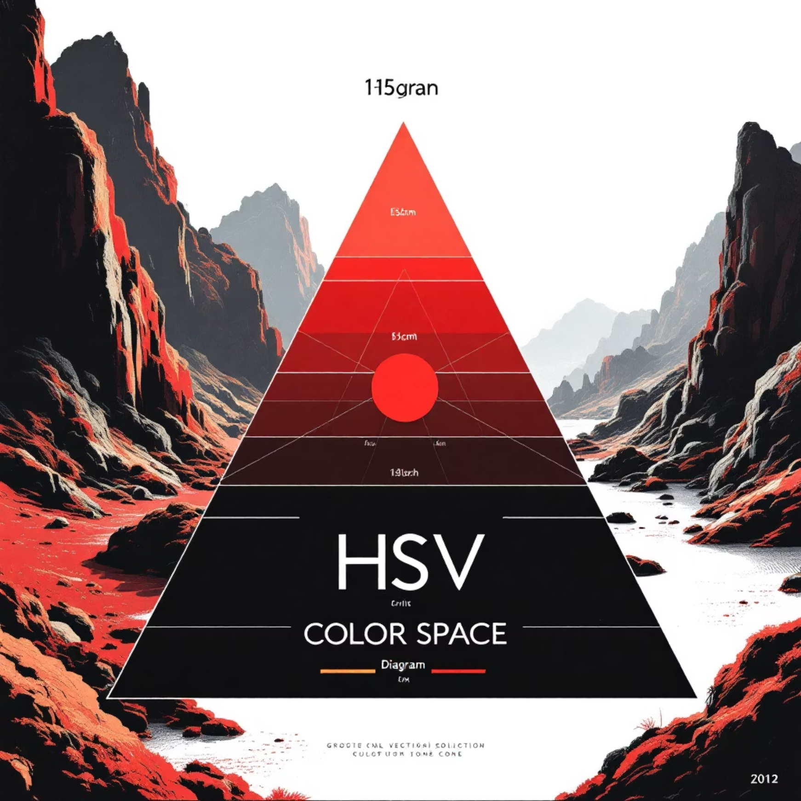

Core Algorithm Design
HSV Color Detection
The system converts RGB frames to HSV color space for robust ball detection under varying lighting. Color thresholds isolate the target ball, followed by contour detection to identify circular shapes and calculate centroid coordinates.
Proportional Control
Servo positioning uses proportional feedback where angular adjustment is directly proportional to the pixel offset from frame center, ensuring smooth tracking with minimal oscillation.
Key Insight: HSV color space provides superior robustness against lighting variations compared to RGB, making it ideal for real-world tracking applications.

Slide 6

Real-Time Decision Making
01
Ball Detection Check
System continuously scans for valid ball contours in camera frame
02
Obstacle Assessment
Ultrasonic sensor measures forward distance; halt and reverse if <20cm detected.
20cm or more turn slightly and keep
03
Position Calculation
Compute ball centroid offset from frame center for error signal
04
Motor Command Execution
Translate tracking error into differential drive commands for pursuit.
Accurate and seamless tracking relies heavily on hardware. A high-speed camera
Can track much more accurately and quickly compared to the camera we have available.

Slide 7



Safety Mechanisms
Ultrasonic Obstacle Detection
Emergency Stop Protocol
Speed Limiting
Maximum velocity capped at 0.5 m/s with gradual acceleration profiles. PWM duty cycle constraints prevent sudden movements that could compromise stability or tracking accuracy.
Continuous forward-facing distance monitoring with 20cm safety threshold. When obstacles detected, robot immediately halts all forward motion and enters safe state.
Software watchdog timer monitors loop execution. If processing exceeds timeout or exception occurs, system triggers immediate motor shutoff and servo reset to neutral positions.

Slide 8
Performance Metrics
System evaluation demonstrates robust tracking and obstacle avoidance capabilities
Performance Metric
Result
Test Conditions
Ball Tracking Accuracy
90%
Indoor lighting, 1-3m range
Obstacle Detection Rate
95%
Various object sizes >5cm
Maximum Speed
0.5 m/s
Smooth floor surface
Processing Frame Rate
15-18 FPS
Raspberry Pi 4B, 720p
Response Latency
<100ms
Detection to motor command
Results validate the effectiveness of the HSV-based detection algorithm and proportional control system for real-time autonomous tracking.

Slide 9


Conclusion & Future Work
Project Achievements
Successfully integrated computer vision with mobile robotics platform
Demonstrated real-time object tracking with 90% accuracy
Implemented robust safety mechanisms for autonomous operation
Validated proportional control for smooth servo positioning
Future Enhancements
Deep Learning Integration: Replace HSV detection with YOLO or MobileNet for multi-object recognition
Path Planning: Implement A* algorithm for intelligent navigation around obstacles
Multi-Robot Coordination: Enable collaborative tracking with robot swarms
Ethical Considerations: This system prioritizes safety through obstacle detection and speed limits. Used exclusively for educational demonstrations with no privacy concerns or surveillance applications.

